Slide 1

02/14/2025
Predicting Customer Behavior by Web-scraping Data
- by Jignesh More

Slide 2
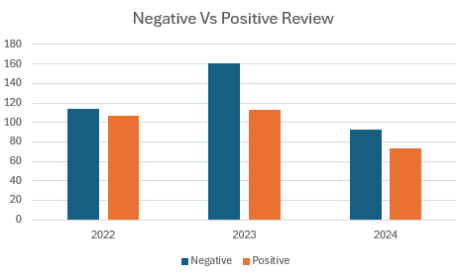
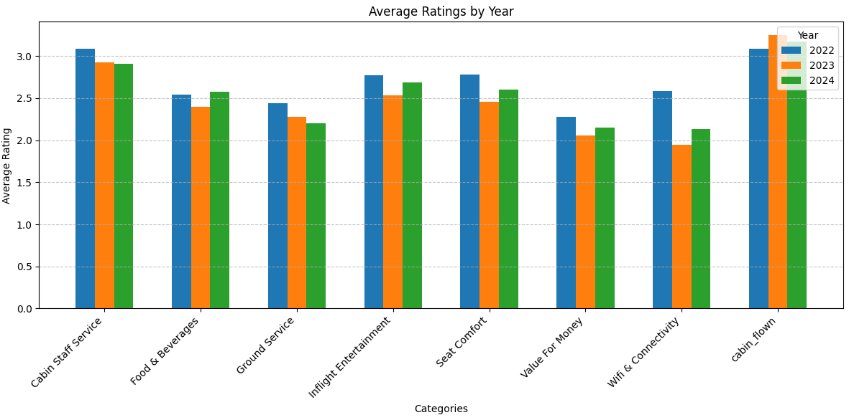

Overall INSIGHTS FROM CUSTOMER REVIEWS
Out of 800 total records, reviews from Last 3 Years were considered (663 reviews)
~56% comment as Negative Overall based on Sentiment Analysis
2024 review were less by 40% vs 2023, along with Negative feedback.
In 2024, British Airline enhanced customer satisfaction by improving at 5 services out of 8 compared to 2023, as mentioned on this chart

Slide 3
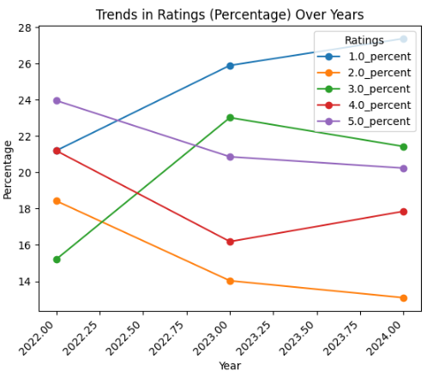
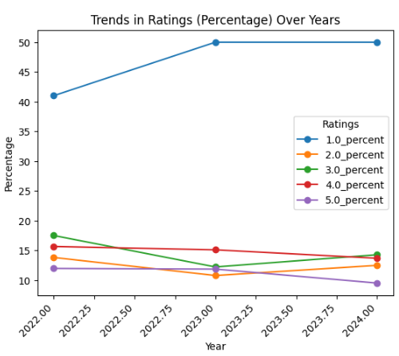
Detail INSIGHTS FROM CUSTOMER REVIEWS
Cabin Staff Service
Ground Service

Slide 4
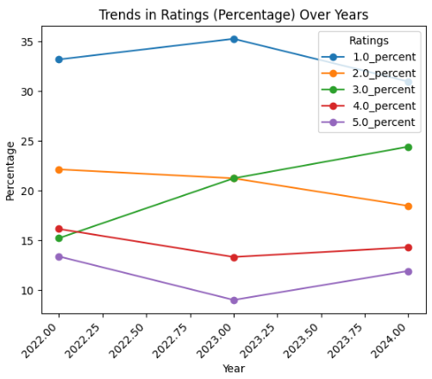
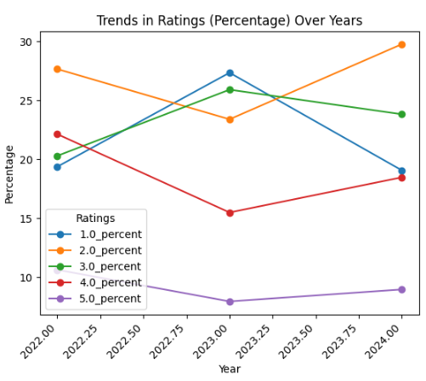
Detail INSIGHTS FROM CUSTOMER REVIEWS
Food & Beverage Service
In-Flight Entertainment

Slide 5
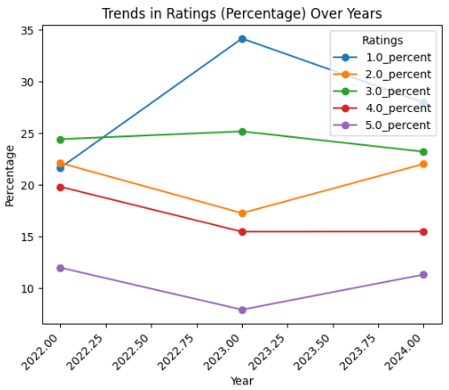
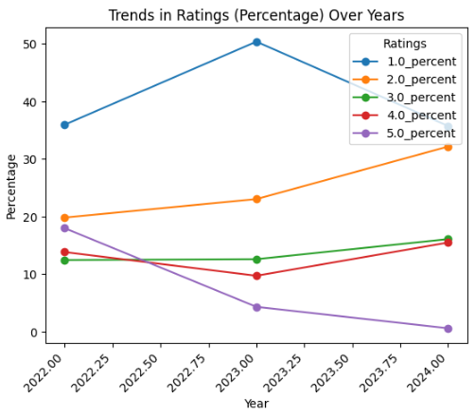
Detail INSIGHTS FROM CUSTOMER REVIEWS
Seat Comfort
Wi-fi Connectivity

Slide 6
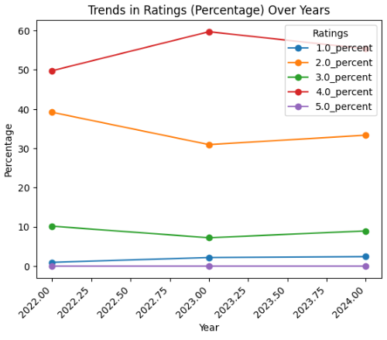
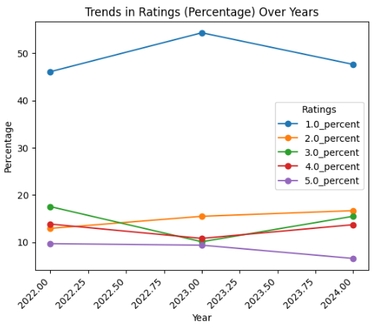
Detail INSIGHTS FROM CUSTOMER REVIEWS
Cabin Flown
Value to Money

Slide 7
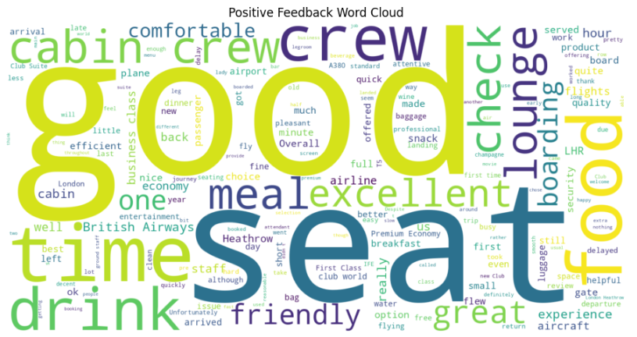
Detail INSIGHTS FROM CUSTOMER REVIEWS
Positive Feedback Word Cloud

Slide 8
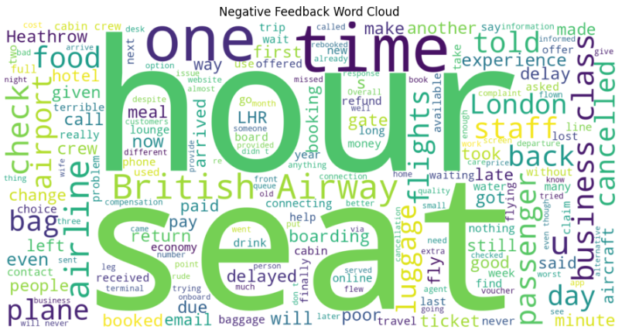
Detail INSIGHTS FROM CUSTOMER REVIEWS
Negative Feedback Word Cloud

